Slide 1
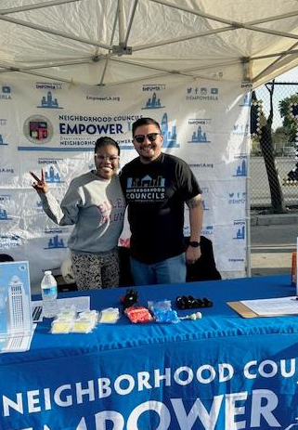


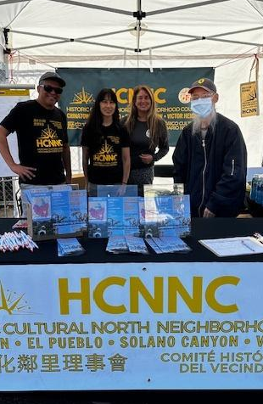



Neighborhood Councils
Awareness & Engagement

Slide 2
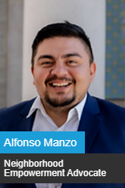

Presenter
Alfonso Manzo, MPA
alfonso.manzo@lacity.org | Neighborhood Empowerment Advocate
Alfonso Manzo serves as a Neighborhood Empowerment Advocate (NEA) at EmpowerLA. He is responsible for supporting Neighborhood Council Boards with capacity building, training, and organizing skills that empower board members and engage the community. Alfonso currently supports South LA, West LA, and the Harbor Regions.
Alfonso's career in public service began with the City of Downey Parks and Recreation Department. His commitment to serving communities led him to roles at various government agencies, including Los Angeles County, the City of Santa Monica, and the City of West Hollywood. Prior to joining EmpowerLA, he served as a Field Representative for Congresswoman Linda Sánchez, working closely with constituents and local leaders to address key policy issues and community needs. In 2022, Alfonso joined EmpowerLA as an Election Assistant, and his dedication and expertise led to his promotion to NEA in 2023.
Born and raised in Downey, California, Alfonso attended Warren High School before pursuing higher education at California State University, Los Angeles, where he earned a Bachelor of Arts in criminal justice with a double minor in business and law. He later continued his academic journey at California State University, Long Beach, obtaining a Master of Policy & Public Administration with an emphasis in employee and employer relations. Alfonso is a dedicated public servant with a strong background in government and community engagement.

Slide 3
Awareness & Engagement
Mission: The division's mission is to connect communities throughout Los Angeles to the Neighborhood Council system through direct public engagement programs, awareness messaging campaigns, strategic community partnerships, civic participation and Neighborhood Council Elections.
Division
Community Engagement
Strengthening Neighborhood Council Leaders
City-wide Communication and Advertising
Community-based Partnerships

Slide 4
Awareness & Engagement
Strategic Action Plan
DEPARTMENT LED
INCREASE AWARENESS OF NEIGHBORHOOD COUNCIL SYSTEM
  General Awareness
  NC Election Awareness
COMMUNICATIONS
  LANGUAGE ACCESS
  NEWSLETTERS/MONTHLY UPDATES
  SOCIAL MEDIA
  TEMPLATES
  FLYERS/POSTCARDS
CIVIC ENGAGEMENT
  EVENTS: TABLING & BOOTHS
  CANVASSING
  PROMOTIONAL SWAG DISTRIBUTION
  SIGNAGE/ADS
CULTIVATE CITY-WIDE COMMUNITY PARTNERSHIPS
  ROUNDTABLE PARTICIPATION
  PARTNERSHIP LISTS
  NC 101 PRESENTATIONS
CONTRACTS
  PROVIDE INFRASTRUCTURE FOR DELIVERABLES
  DATA COLLECTION USING CBO NETWORK
  USE TRUSTED MESSAGING AMBASSADORS
DEPARTMENT TO NC
OUTREACH WORKSHOPS
ENGAGEMENT TOOLS AND GUIDES
OUTREACH PLAN SUPPORT
DEVELOPMENT OF STRATEGIC OUTREACH
EVENT SUPPORT & STAFFING

Slide 5



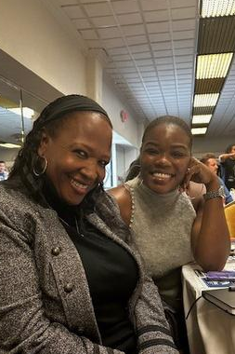



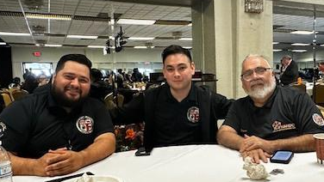

Outreach
Committees
PROMOTE THE NC
HOLD COMMITTEE MEETINGS
ROLE & RESPONSIBILITIES
Create awareness of the work, meetings, activites of the board.
Goal: Increase Impact!
Planning and discussion of initiatives and events with public input.
SEEK ENGAGEMENT METHODS
REPORT TO & ENGAGE THE BOARD
Create paths to engage your community via in-person, communications, social media, etc
Recommend and request board action around events, purchases and focus.

Slide 6
RESPONSIBILITIES OF OUTREACH COMMITTEES
PROMOTE THE NC | HOLD COMMITTEE MEETINGS | INVOLVE THE BOARD
Social Media Newsletters Community advertising CBO Outreach | Recruit board members and stakeholders to participate | Monthly report to the board with activities and requests
Website: Upcoming events and meetings ‘Get Involved’ invitation Board Application | Decide on focus, compose NC outreach events calendar, inventory of all outreach materials | Bring funding and event requests to board for approval
Seeking Community Events Sponsoring and Co-Sponsoring Tabling events | Recommend on how the outreach budget should be spent | Involve the board in execution of events and activities
Outreach Committee
Activities

Slide 7
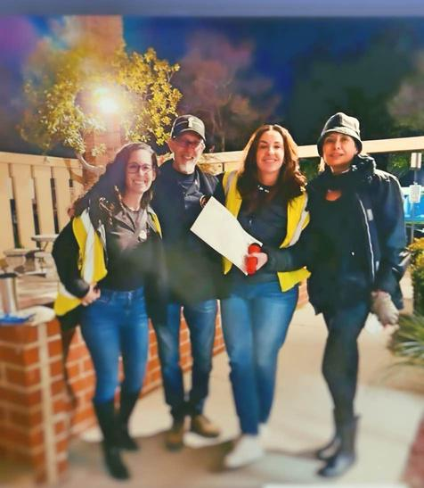

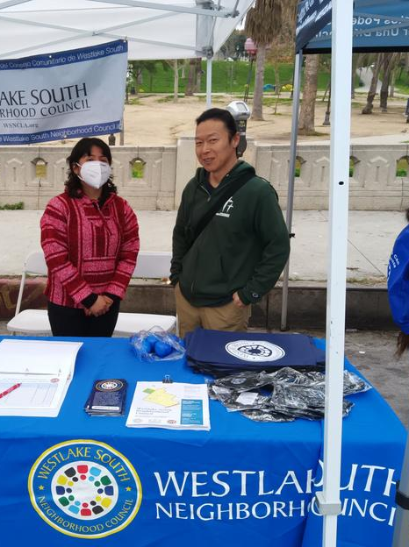

Planning
WHAT ARE SOME THINGS THAT YOU WOULD LIKE TO ACCOMPLISH THIS YEAR?
Ahead!
WHAT ARE SOME OUTREACH CHALLENGES?
WHAT ARE THE NEEDS AND PRIORITIES IN OUR NEIGHBORHOOD?
HOW CAN YOU ENGAGE THE PUBLIC IN YOUR WORK?

Slide 8
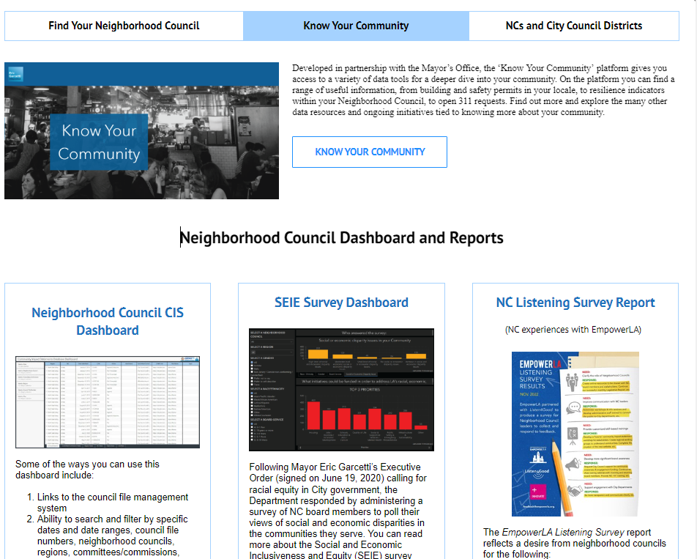
Know Your Neighborhood
GUIDES & CHECKLISTS
The EmpowerLA Data page has tools to empower you in knowing your Neighborhood

Slide 9
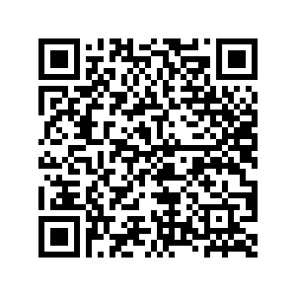


Outreach
Tool Kit
GUIDES & CHECKLISTS
  QR code and Virtual Card generator
  Direct Mailers - Bulk Mail Guide
  NC Event Checklists
  Bus & Bench Ad programs
  ‘Get Involved’ flyers
  Coloring & Activity Sheets
  Engagement Plan Checklist
THIS IS ONLY THE BEGINNING...

Slide 10
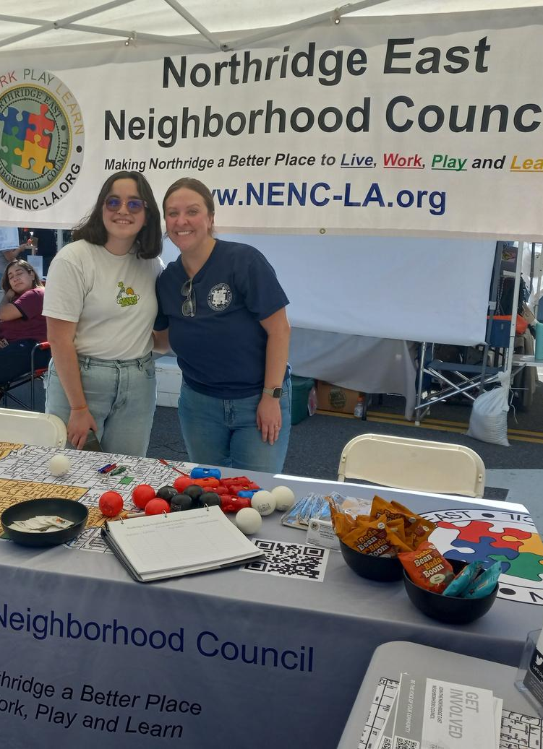

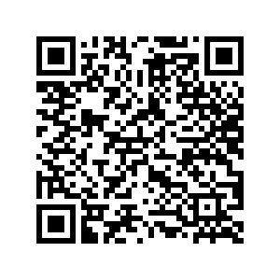
Creating A Purpose: Outreach Strategic Action Plan
for Your NC
01
CLEAR GOALS
02
ACTIONS TO REACH THOSE GOALS
03
MEASURABLE OUTCOMES
Focused
Maximize Impact
Be realistic
Activities, partners, funding, dates, etc.
Track if you are on your way.
Know if you have to correct course.

Slide 11


Thank You!
REACH OUT FOR ANY QUESTIONS & TO SCHEDULE 1:1 TIME
EMAIL
alfonso.manzo@lacity.org
  PHONE
  213-935-5099

